Slide 1


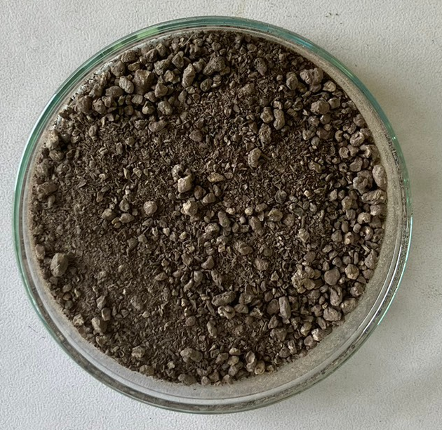
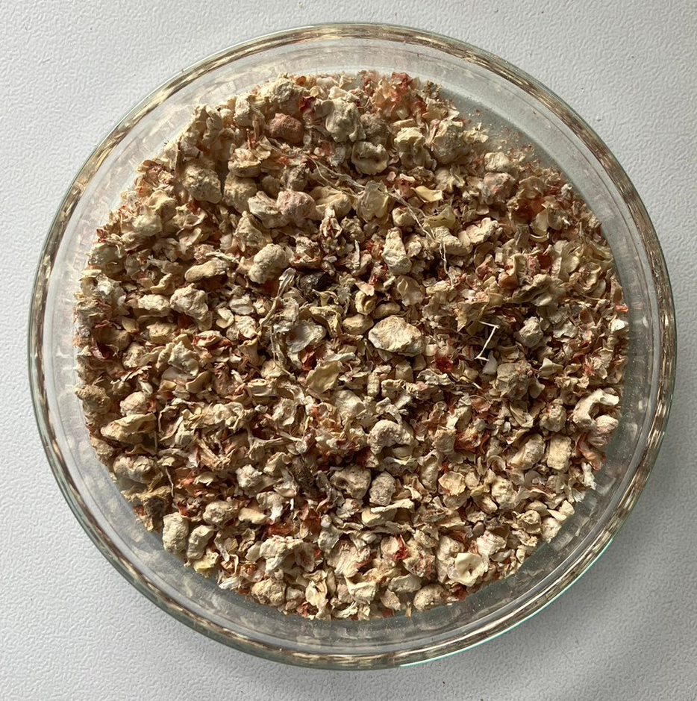
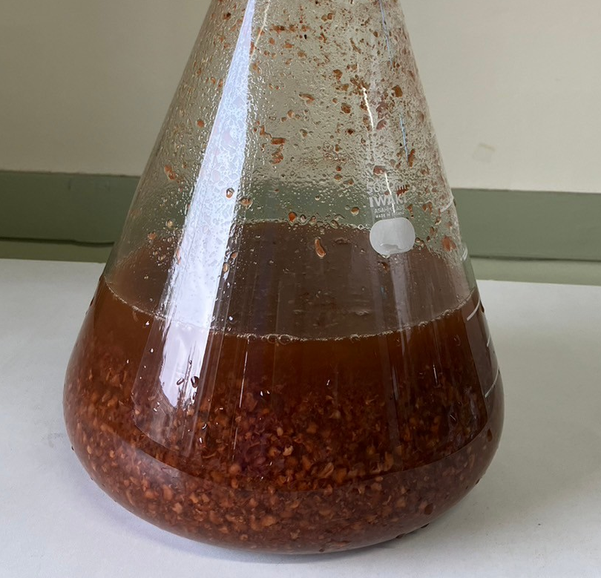
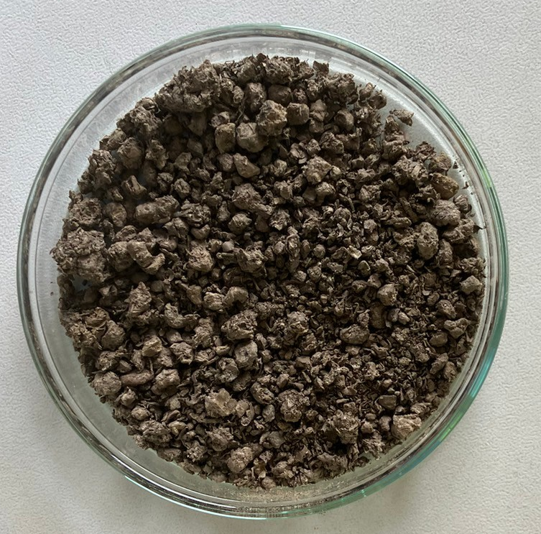
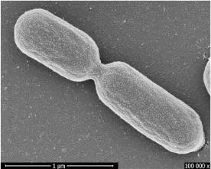
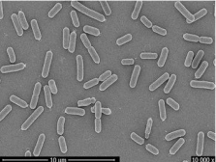
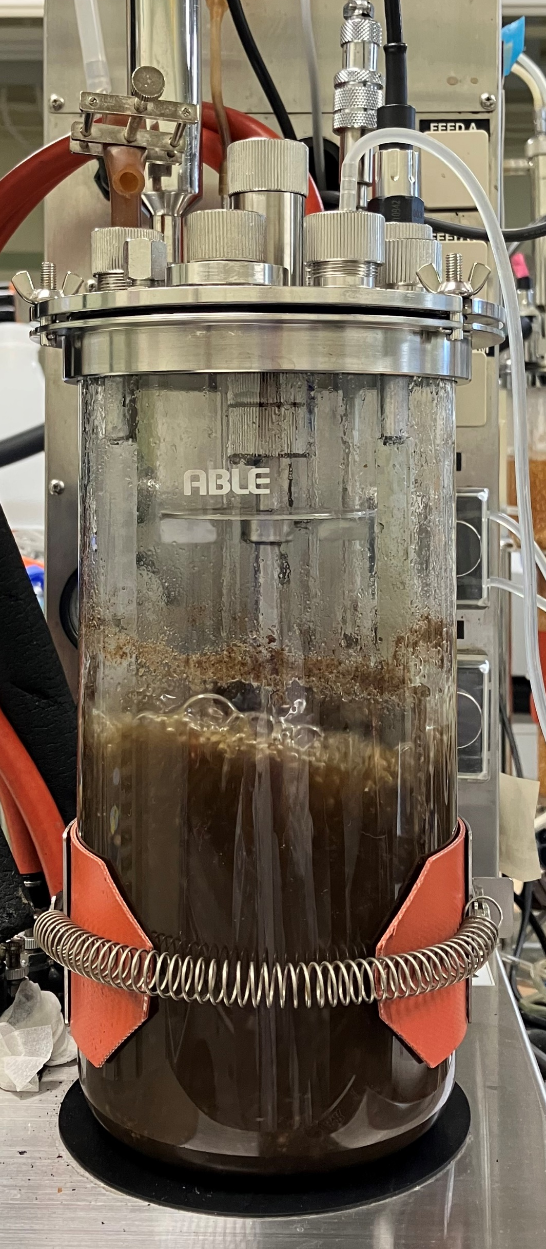
QB120
SCEJ 56th Autumn Meeting, Sep, 16th 2025
好熱性Bacillus smithiiを用いた高温同時糖化発酵によるL-乳酸生産プロセスの効率化
Efficient L-lactic acid production by high temperature
simultaneous saccharification and fermentation using thermophilic Bacillus smitii
(Kyoto Inst. Tech.)○Kirika Ogawa･ Jun-ichi Horiuchi･Yoichi Kumada*
Introduction
Results and discussion
Lactic acid production from lignocellulosic biomass
Lactic acid production by SSF using B. smithii at 50 ℃
Simultaneous Saccharification and Fermentation
Conditions | SSF at 30 ℃ | SSF at 50 ℃
LA conc. (g/L) | 25.8 | 24.7
LA productivity (g/L/h) | 0.98 | 1.81
LA yield (g/g-Cellulose) | 0.86 | 0.82
Saccharification
Fermentation
Cellulase
Lactic acid bacteria
CCR
Glucose
（LAB)
L-lactic acid
×1.8
Saccharification
Fermentation
SSF at 30 ℃
Microaerobic
Optimal temperature of Cellulase at 50 ℃
Mesophilic LAB
Rate limiting step
⇒ Saccharification
Anaerobic
growing at 30 ℃
〈 Objective 〉
Lactic acid production from CCR by SSF at high temperature under initial aerobic condition
【50 ℃, 400 rpm，CCR = 50 g】
L-lactic acid was successfully produced from CCR by SSF using B. smithii at 50 ℃.
Efficient lactic acid production
by high temperature SSF
using thermophilic LAB B. smithii
High-level lactic acid production by fed-batch SSF at 50 ℃
9 h、24 h
+CCR 50 g
+Meicelase 5 g
CCR (g-dw/L) | 50 | 50+50 | 50+50+50
LA conc. (g/L) | 24.7 | 45.4 | 56.4
LA productivity (g/L/h) | 1.81 | 1.16 | 1.12
LA yield (g/g-Cellulose) | 0.82 | 0.81 | 0.70
Fermentation
SSF at 50 ℃
Thermophilic Bacillus smithii
Optimal growth temperature : 50~60 ℃
Materials and methods
Preparation of Corn Cob Residues (CCR)
Microaerobic
Hydrolysis
(1.5％H₂SO₄)
Washing
and dry
Pulverizing
Anaerobic
121℃、60min
Lactic acid production was achieved at high concentration by fed-batch SSF
Productivity was decreased due to
spore formation of B.smithii
Corn cobs
(Cellulose content 33 %)
Hydrolysis
Corn cob residues
CCR
Pulverized CCR
(Cellulose content 60 ％)
Time courses of lactic acid production by fed-batch SSF with initial aeration【50 ℃, 400 rpm】
Medium
Strain
⇒ Some components in R medium might be deficient
R medium
Peptone | 10 g/L
Malt extract | 5 g/L
Yeast extract | 5 g/L
Casamino acid | 5 g/L
Beef extract | 2 g/L
MgSO₄・7H₂O | 1 g/L
Tween 80 | 0.05 g/L
Bacillus smithii (JCM9076)
Effects of medium concentration on lactic acid production using B.smithii
・Optimal temperature 55 ℃
(25~65 ℃)
・Optimal pH 5.5~7.0
・Facultative anaerobes
Growth characteristics of thermophilic
B. smithii at different temperatures
Analytical methods
Enzyme (Cellulase)
・Lactic acid
F kit D/L-lactic acid
(J. K. international Inc) .
HPLC
（JASCO corp.）
・Glucose
HPLC
（JASCO corp.）
Meiselase
・Meiselase from Trichoderma
viride, Meiji corp.
・Optimal pH
pH 5.0 (3.0〜6.0)
・Specific activity
518 FPU/g (30 ℃)
・Optimal temperature
50 ℃ (45〜55 ℃)
The saccharification of
CCR using Meicelase was maximized at 50 ℃.
 | Initial aerobic 1×R medium | Anaerobic 1×R medium | Anaerobic 2×R medium
LA conc. (g/L) | 56.6 | 59.1 | 77.0
LA productivity (g/L/h) | 0.98 | 1.05 | 1.59
LA yield (g/g-glucose) | 0.77 | 0.71 | 0.73
Saccharification of CCR by Meicelase
at different temperatures
Simultaneous saccharification and fermentation (SSF)
×1.5
SSF was performed by adding cellulase and inoculum into the fermenter at the same time.
Inoculation of
B. smithii
Fermentation Conditions
Temperature (℃) | 50
pH | 6.0
Agitation speed (rpm) | 400
Liquid volume (L) | 1.1
Effects of aeration and medium composition on lactic acid production using B.smithii
【50 ℃, 400 rpm，Constant glucose conc. 】
・R medium 1.0 L
・CCR 50 g-dw
・Meiselase 5 g
(51.8 FPU/g-CCR)
Productivity increased by use of 2-times concentrated R medium.
Future plan
Initially aerated
0~7 h⇒Micro aerobic
7 h~ ⇒Anaerobic (N₂ gas)
✓Optimization of medium components for efficient lactic acid production
✓Achievement of high productivity and high concentration of lactic acid
by SSF at high temperature
Notes:
耐熱性乳酸菌Bacillus smithiiを用いた高温同時糖化発酵によるバイオマスからのL-乳酸生産
L-lactic acid production using thermotolerant Bacillus smithii from biomass by simultaneous saccharification and fermentation at high temperature

