Slide 1

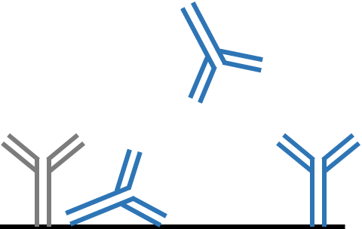

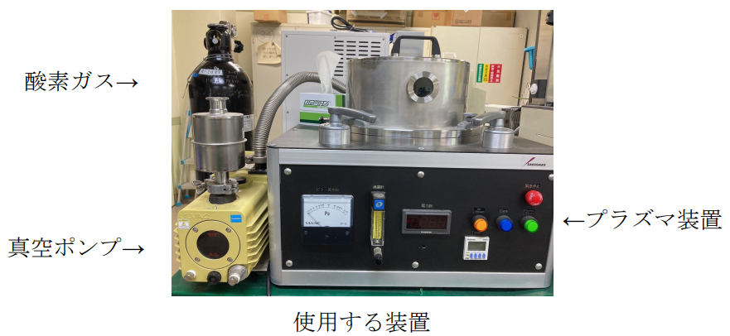
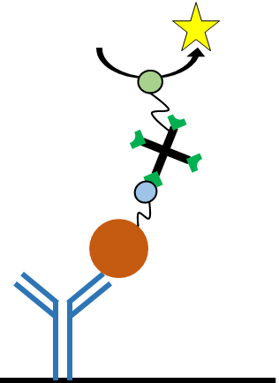

PA131
酸素プラズマ照射ニトロセルロース膜に対する抗体の吸着特性
及び残存活性の評価
SCEJ 90th Annual Meeting
Characterization of adsorption and residual activity of antibodies on the surface of nitrocellulose membrane irradiated by oxygen plasma
(Kyoto Inst. Tech.) ○(Stu) Manami Takata・ (Stu) Yuki Nagahisa ・(Toyo Roshi) Toshihiro Nakanishi・(Toyo Roshi) Yoshihiko Inaba・ (Kyoto Inst. Tech.) (Reg) Jun-ichi Horiuchi・(Reg) Yoichi Kumada *
Introduction
Results and discussion
Nitrocellulose membrane (NC membrane)
Characterization of adsorption and residual activity of antibodies immobilized on the surface of NC membrane
Porous and hydrophobic membrane used for antibody immobilization in immunochromatography
〇High water absorption property
〇High adsorption capacity of proteins
△Proteins might be strongly interacted on the surfaces by multiple types of interactions such as
C
T
・Hydrophobic interaction
・Hydrogen bonding
・Electrostatic interaction etc
Ex) If the adsorption condition is not appropriate,
Adsorption Residual activity
Conformational changes
Desorption
After adsorption
NC membrane
In this study, we focused on oxygen plasma treatment, which is one of the popular surface modification methods
The adsorption and residual activity of monoclonal antibody on the oxygen plasma-irradiated NC membrane were investigated.
Objective
・Washing with TBST significantly dissociated the adsorbed antibodies at pH 5-8 .
・Antigen-binding activities of antibodies that were adsorbed at neutral pH
(pH5-8) were relatively maintained at high levels.
・It was found that adsorbed antibodies were inactivated under the acidic and alkaline conditions.
Development of NC membranes suitable for antibody immobilization by oxygen plasma treatment
Materials and methods
Antigen-binding activities of monoclonal antibodies adsorbed on NC membranes irradiated by oxygen plasma
Materials
◆NC membranes
Membrane for Immunochromatography IAB135-EX (Advantec)
◆Antibodies
Mouse IgG (Fujifilm WAKO)
Anti-hCG Mouse mAb(4G2) (Advantec)
◆Antigen
Human Chorionic Gonadotropin(hCG) (Merck)
◆Buffer
pH | 1-3 | 4 | 5-6 | 7-8 | 9-12 | 13-14
Buffer | Gly-HCl | Acetate | MES | Tris-HCl | Gly-NaOH | KCl-NaOH
◆Sample solution
Component | Concentration
Antibody | 0～400 µg/mL
Buffer | 50 mM
・Treatment of NC membranes at 10 Pa improved the residual activity of monoclonal antibody after adsorption.
Methods
Effect of antibody concentration on antigen-binding activity
◆ Oxygen plasma conditions
◆ Spotting and washing
Oxygen plasma irradiation
Spotting the sample
solution on NC
membrane(2 μL)
Washing methods
Adsorption characterization
Washing with TBST (10 min)
Washing with mili-Q water (10 min)
Residual activity check
◆ Adsorption characterization
◆ Residual activity check
・Antigen-binding signals were increased with concentrations of antibody spotted.
・CBB staining and decolorization
・Washing with milli-Q water
・Scanning by Image J
BCIP/NBT
Conclusion
SA-AP
・Blocking with 2% BSA-TBS
・Reaction with Bt-hCG (10 ng/mL)
・Reaction SA-AP
・Enzymatic reactions with BCIP/NBT
・Scanning by Image J
✔ Characteristics of antibody adsorption and residual activity on NC membrane were clarified.
✔ It was suggested that the surface properties of NC membrane were changed by oxygen plasma treatment under the low pressure condition.
✔ Oxygen plasma irradiation has a potential to improve antigen-binding activities of antibodies after adsorption.
protein
CBB staining
Bt-hCG
NC membrane
Antibody
NC membrane

