Slide 1
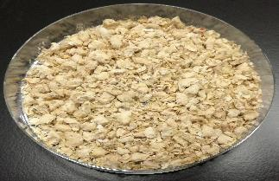
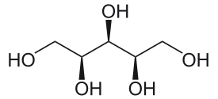
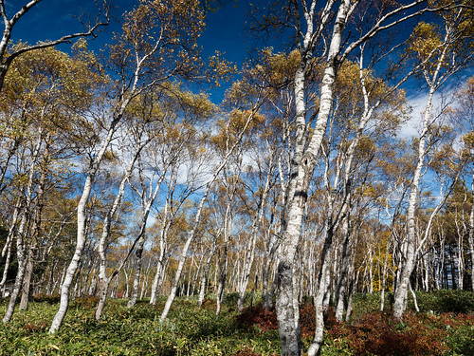
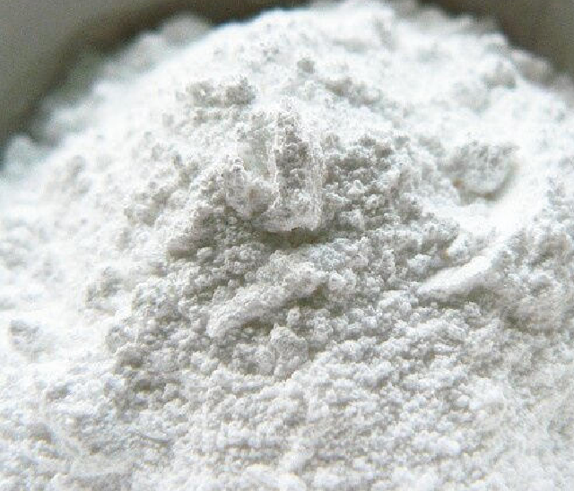
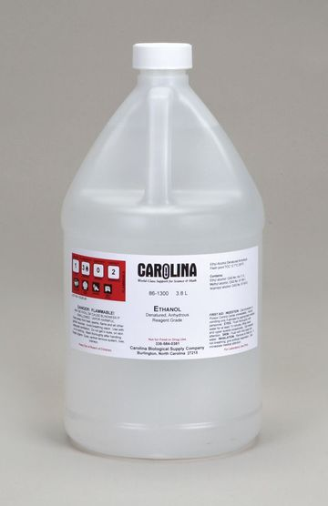
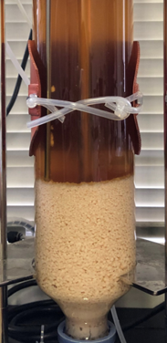
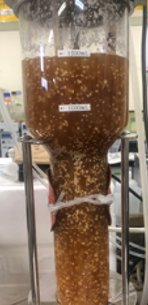
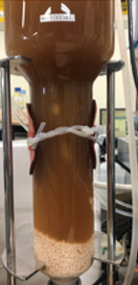
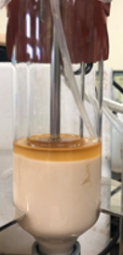
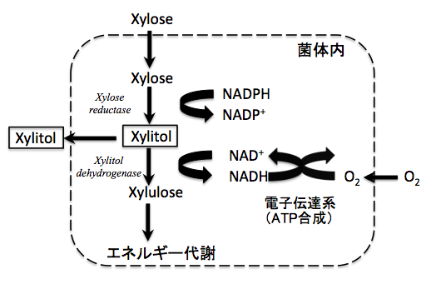
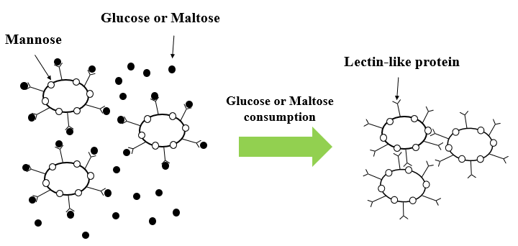
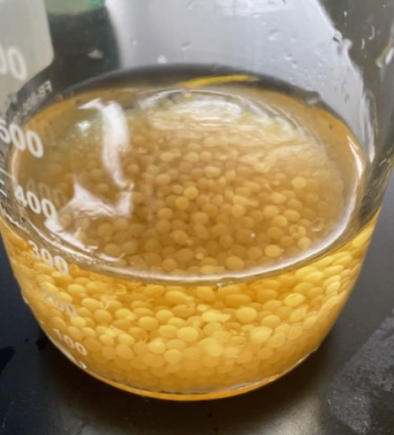
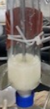
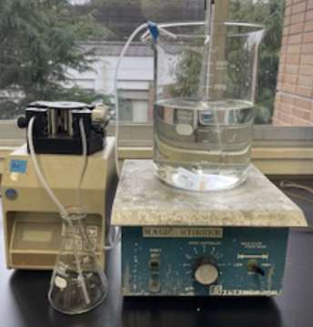
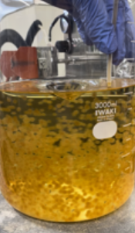
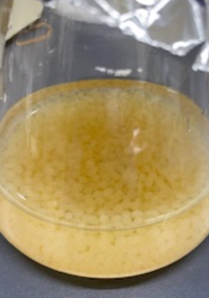
酵母の共培養によるバイオマスからのエタノールとキシリトールの同時生産
Production of ethanol and xylitol by co-cultivation of yeasts from lignocellulosic biomass
(Kyoto Inst. Tech.) ○Taiki YAMAWAKI・Yoichi KUMADA・Jun-ichi HORIUCHI*
YA167
Introduction
Results and Discussion
Repeat batch culture with immobilized bacteria
Effective biological utilization of biomass
Procedure for repeated batch culture based on co-cultivation
Batch culture for xylitol production by air-lift
Acid hydrolysis
Hemicellulose
Xylose
Corn cobs
Cellulose
Corn cobs
residue
Glucose
Saccharification
It is important to use both xylose and glucose
Xylitol
Ethanol
Cultivation
Settlement
Broth
withdrawal
Medium
replacement
・Five-carbon sugar alcohol
・Natural sweetener for
food and medical usage
・Volatile colorless liquid
・Various uses such as disinfectants
and sterilizers, food additives, fuel, etc.
Time courses of batch fermentation for xylitol production
Industrial xylitol production
Industrial ethanol production
Co-cultivation using C. magnoliae and flocculent yeast
Forest resources
Chemical
hydrogenation
Xylitol
Petroleum→Naphtha
Ethylene
Ethanol
S. cerevisiae
Enhanced xylitol and ethanol production based on
co-cultivation of xylitol-producing yeast and flocculent yeast
Materials and Methods
Flocculent yeast
Co-cultivation
Settlement
Withdrawal of culture broth
Strains
Candida magnoliae (FERM P-16522)
Saccharomyces cerevisiae (NBRC1953)
C. magnoliae
Medium replacement
xylose
Mannose
Glucose or Maltose
Lectin-like protein
xylitol
xylose
xylitol
ATP synthesis
Energy metabolism
Glucose or Maltose consumption
Metabolic pathway of C. magnoliae
Mechanism of aggregation
Medium
Xylitol production medium |  | YMP medium
Xylose | 30 g/L | Glucose | 30 g/L
YNB | 1.7 g/L | Yeast Extract | 3.0 g/L
Urea | 2.27 g/L | Malt Extract | 3.0 g/L
Casamino Acids | 1.0 g/L | Peptone | 5.0 g/L
Working volume | 1500 mL
Temperature | 30 ℃
pH | 7.0
Air flow rate | 0.2～0.6 vvm
Time courses of repeated batch fermentation for xylitol production by air-lift bioreactor using co-culture of S. cerevisiae and C. magnoliae
Fermentation conditions
Procedure for repeated batch culture based on co-cultivation
Xylitol concentration, yield, productivity and ethanol productivity of batch fermentation for xylitol production by air-lift bioreactor using co-culture of S. cerevisiae and C. magnoliae
 | Xylitol conc. | Xylitol yield | Xylitol productivity | Ethanol productivity
1 | 16.8 g/L | 68 % | 0.25 g/L/h | -
2 | 21.4 g/L | 67 % | 0.26 g/L/h | 4.49 g/L/h
3 | 21.7 g/L | 71 % | 0.26 g/L/h | 3.36 g/L/h
4 | 21.5 g/L | 68 % | 0.26 g/L/h | 5.38 g/L/h
Air-lift bioreactor
pH sensor
Repeated batch culture using immobilized C. magnolliae
Co-cultivation
Flocculation
Settlement
pH
controller
NaOH
Peristaltic pump
Working volume: 1500 mL
Medium replacement
Immobilized yeast
Cultivation
Settlement
Withdrawal of culture broth
Air
Flocculent yeast
Addition of medium
Cell immobilization
Xylitol-producing yeast
Xylitol productivity : 0.32 g/L/h → 1.20 g/L/h
Sodium alginate | 10 g/L
CaCl2 | 0.1 M
Penicillin G potassium | 5000 Unit/L
Conclusions
Repeat batch culture with immobilized bacteria
・Co-cultivation of C. magnoliae and S. cerevisiae was successfully performed
using an air-lift bioreactor.
・4 cycle of repeated culture was demonstrated.
・Further research is required to improve xylitol productivity.
Immobilized C. magnoliae

