Slide 1


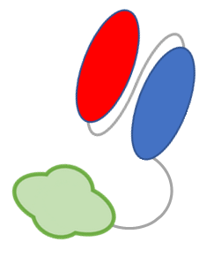
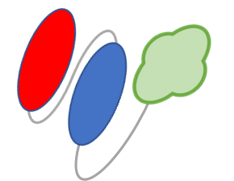

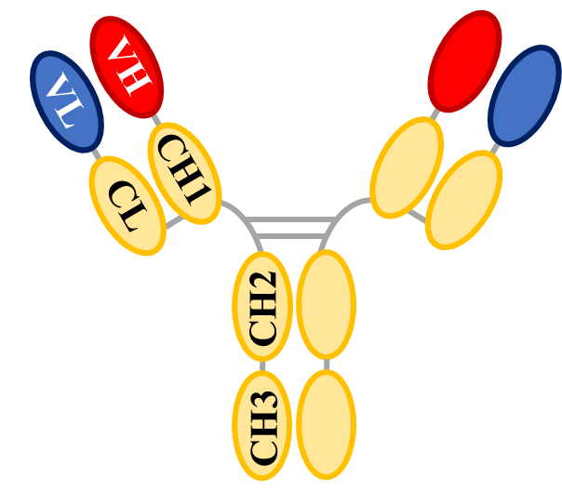


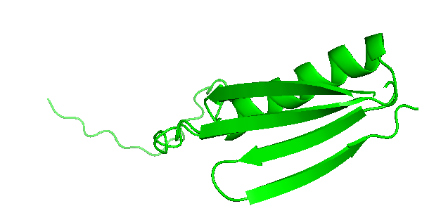

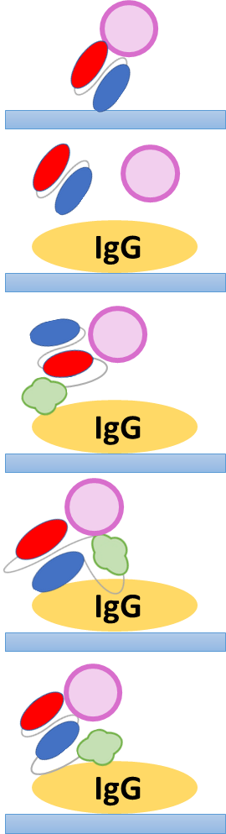


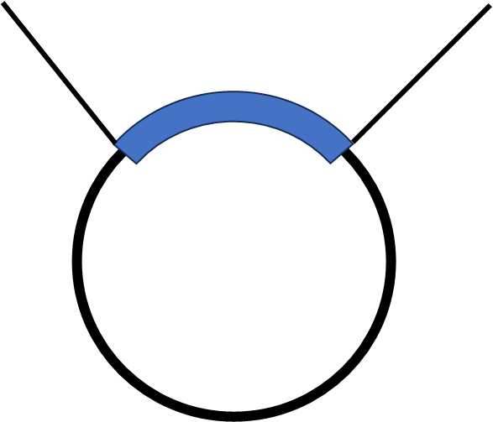


YA141
SCEJ 55th Autumn Meeting
Ig結合ドメイン融合ウサギ単鎖抗体の設計と機能化
Design and Characterization of rabbit single-chain Fv antibodies fused
with Ig-binding domain
(Kyoto Inst. Tech.) ○(Stu) Shogo Ito・Haruka Taniguchi ・(Reg) Jun-ichi Horiuchi・(Reg) Yoichi Kumada *
Introduction
Results and discussion
Subjects of antibody-coated plate
Production of PpL1-fused scFv variants
Antigen
 | Sample | Supernatant (mg/L) | Lysate (mg/L) | Total Soluble protein (mg/L)
 | scFv | 68.0 | 32.0 | 100.1
PpL1-fused scFvs | Type A | Not detected | 30.5 | 30.5
 | Type B | 17.0 | 144.2 | 161.2
 | Type C | 13.0 | 107.9 | 120.9
Application to immunoassays
・Lateral-flow immunoassay
・Latex turbidimetric assay
・ELISA
・CLEIA
Denaturation
Antibody
✖ Denaturation
✖ Uncontrollable orientation
Low activity
PpL1-fused scFvs were recovered at the different production levels due to fusion position.
・Type B and Type C were efficiently expressed and located at the culture supernatant.
Alternative immunoadsorbent using PpL1-fused scFv
Antigen-binding activities of PpL1-fused scFvs
onto antigen-coated plate
Antigen-binding site
HRP-Mouse anti-6×His tag
scFv
0～2 µg/mL
PpL1-fused scFv
Ig-binding domain
(PpL1)
IgG
IgG
IgG
✔ Efficient and site-directed immobilization
✔ Highly active and accessible antigen recognition
10 µg/mL
CRP
Ig-binding domain (PpL1)
・Variants Type B and Type C showed higher antigen-binding activities than original scFv.
Protein L
Binding to VL domain of antibody
Kinetic analyses of IgG-binding by SPR sensor
PpL1-fused scFv
 | Sample | k_{on} (1/Ms) | k_{off} (1/s) | K_{D} (M)
 | PpL1 | 5.82×10⁵ | 1.56×10⁻³ | 2.69×10⁻⁹
PpL1-fused scFvs | Type A | 3.19×10⁴ | 4.52×10⁻⁴ | 1.42×10⁻⁸
 | Type B | 4.87×10⁴ | 4.76×10⁻⁴ | 9.78×10⁻⁹
 | Type C | 7.57×10⁴ | 3.07×10⁻⁵ | 4.05×10⁻⁹
Binding
Human IgG
Sensor chip CM5
Origin: Peptosterptococcus magunus
MW: 76～106 kDa, pI: 4.8
Whole IgG
scFv
・All variants maintained IgG-binding activities while the variant type C showed
comparable affinity to the original PpL1.
Single Ig-binding domain (PpL1)
Antigen-binding signals detected by PpL1-fused scFv-plates
・Binding VL domain of IgGs and scFvs
・High solubility and thermal stability
・High expression by E.coli
SA-HRP
1 µg/mL
Bt-CRP
0～5 µg/mL
PpL1-fused scFv
0～5 µg/mL scFv
MW: 10.3 kDa, pI: 4.5
Human IgG
Objective
Generation and characterization of PpL1-fused scFvs for development of high-active immunoadsorbent
Materials and methods
PpL1-fused scFvs
Design of PpL1-fused scFv variants
Model : Rabbit anti-CRP scFv C2R
Type A
PpL1
VH
VL
・PpL1-fused scFv-plates could detect higher antigen with activities than conventional plate.
・The variant, Type C showed the highest activity among all tested.
N’
PpL1
VH
VL
His-tag
C’
N’
C’
Antigen detection in One-step method on IgG-plates
MW: 36.1 kDa, pI: 5.85
Absorption (scFv)
Three-step (Type C)
One-step (Type C)
Type B
N’
0.25 µg/mL
HRP-scFv
0.3, 2.5, 10 µg/mL
Type C
N’
VH
PpL1
VL
His-tag
C’
C’
0.3, 2.5, 10 µg/mL scFv
0～1 µg/mL
CRP
Human IgG
Type C
MW: 36.1 kDa, pI: 5.85
Human IgG
N’
C’
N’
VH
VL
PpL1
His-tag
C’
MW: 36.1 kDa, pI: 5.85
Production and characterization of PpL1-fused scFvs
Transformation
Cultivation
Purification
・ One-step method resulted in the most sensitive detection of antigen among tested.
・ The antibody amounts could be reduced in one-step method.
PpL1-fused scFv
Overnight Express TB medium
50 mL (+Amp)
30 ℃, 200rpm
24 hours
◆Ni-NTA agarose (1 mL)
Binding buffer
20 mM Imidazole
2×PBS pH 8.0
Elution buffer
250 mM Imidazole
2×PBS pH 8.0
pET22b(+)
vector
E. coli
C43 (DE3)
Conclusions
Analysis
Characterization
✔ Three different types of PpL1-fused scFvs were designed and successfully prepared by recombinant E.coli.
✔ All PpL1-fused scFv variants maintained both antigen-binding and Ig-binding activities, while the variant, Type C was the best among tested.
✔ PpL1-fused scFv-coated plate could detect the antigen with higher signals than the conventional scFv-coated plate.
✔ One-step method enabled rapid and more sensitive detection of antigen by sandwich ELISA.
◆ Protein Assay
◆ SDS-PAGE
◆ Indirect ELISA by using CRP-plates
◆ Sandwich ELISA by using PpL1-fused scFvs -plates
◆ Expression level
◆ Ig-binding affinity
◆ Antigen-binding activity
◆ Antigen detection
◆ One-step antigen signal detection

